Slide 1
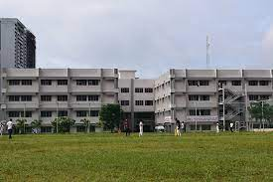

Dhole Patil College of Engineering,Pune
Affiliated to Savitribai Phule Pune University
Approved by AICTE
Department Of First Year Engineering
A
Project Based Learning – Project Report
on
“”Smart Attendance System
Using face recognition.”
By Under the guidance of
Anup Jagtap &
Aniket Jagtap. Prof. Swapnil Rokade

Slide 2
CONTENT
Introduction
Advantages and Disadvantages
Conclusion
Risk Assessment
Budget Formation
Prototyping
Needs Assessment
Scoping
Set Objectives
Plan of Action
Project Schedule
Testing
Redesigning
Aim and Objectives
Applications

Slide 3
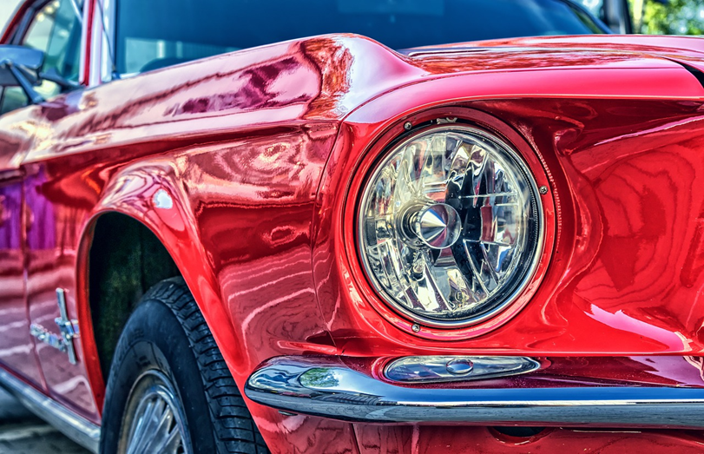
INTRODUCTION
A smart attendance system refers to a technological solution that automates and streamlines the process of recording and managing attendance in various settings, such as schools, colleges, workplaces, and events.
They can automatically identify individuals using biometric features such as fingerprints, facial recognition, or iris scans, ensuring a high level of accuracy and preventing proxy attendance.
The implementation of smart attendance systems brings various advantages. It reduces administrative workload by automating attendance tracking and generating comprehensive reports.

Slide 4
Aim and Objectives
The aim of a smart attendance system is to provide an efficient, accurate, and automated method for recording and managing attendance in various settings.
The system aims to replace traditional manual methods with advanced technologies to streamline the attendance management process.
The system aims to automate the attendance tracking process, eliminating the need for manual entry and reducing administrative workload
01
02
03

Slide 5
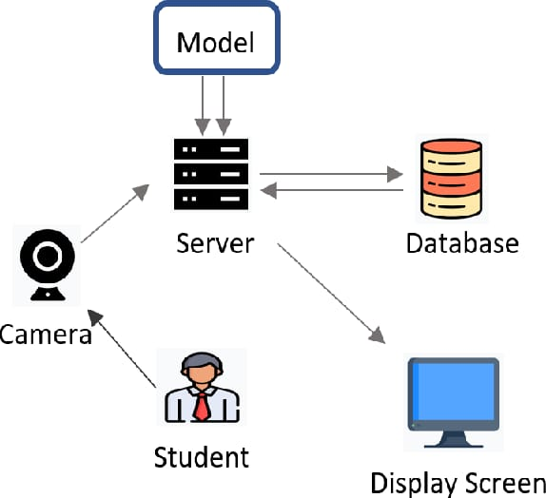
FLOW CHART

Slide 6
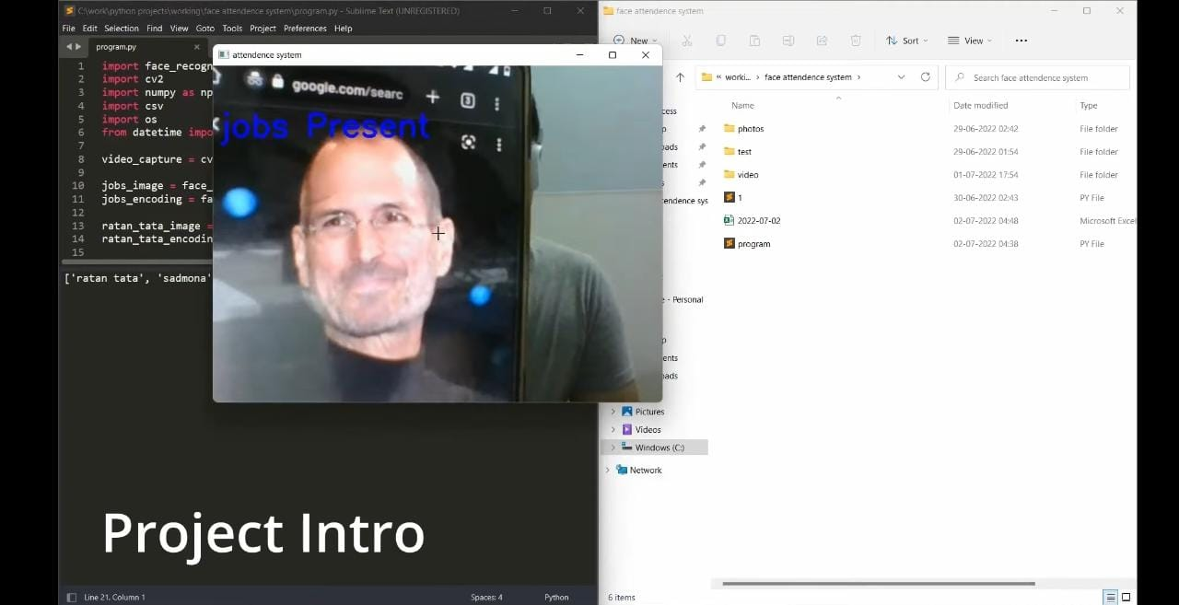
PROGRAM OUTPUT

Slide 7
ADVANTAGES
DISADVANTAGES
Accuracy
Automation
Time-saving
Improved Security
Scalability
Privacy Concerns
False Recognition
Hardware Requirements
Technical Challenges
System Reliance
Ethical Considerations

Slide 8
ADVANTAGES
DISADVANTAGES
Accuracy
Automation
Time-saving
Improved Security
Scalability
Privacy Concerns
False Recognition
Hardware Requirements
Technical Challenges
System Reliance
Ethical Considerations

Slide 9







APPLICATION
Face Recognition
.
Capture Images
Face Detection and Recognition
User Interface
Integration with Existing Systems
Data Analytics and Reporting
Scalability and Security

Slide 10

REFERENCE
www.i-know-python.com
www.github.com.
Python 3.11.3
pypl.org
www.youtube.com
www.wikipedia.com

Slide 11
CONCLUSION
In conclusion, the smart attendance system developed using Python is an efficient and effective solution for automating the attendance management process. By leveraging computer vision techniques and machine learning algorithms, the system is capable of accurately and automatically recognizing individuals and recording their attendance.

Slide 12


ANY QUESTIONS

Slide 13
THANK YOU
Thanks to everyone present here.

